Slide 1

Cloud Computing

Slide 2

Contents
01
Cloud Understanding
02
Security

Slide 3
01
Cloud Understanding
Cloud computing: is the delivery of different services through the Internet. These resources include tools and applications like data storage, servers, databases, networking, and software. ... As long as an electronic device has access to the web

Slide 4

Cloud Computing Deployment Models
Full Cloud
Hybrid
On-premises

Slide 5
Benefits
Trade capital expense for variable expense
Benefit from massive economies of scale
Stop guessing capacity
Increase speed and agility
Stop spending money on running and maintaining data centers:
Go global in minutes

Slide 6


02
Security
02
此处输入标题文本
We have many PowerPoint templates that has been specifically designed to help anyone that is stepping into the world of PowerPoint for the very first time.

Slide 7
Identity and Access Management (IAM)
collection of IAM users that simplify specifying and managing permissions for multiple users
person or application that is defined in an AWS account
tool for granting temporary access to specific AWS resources
document that defines permissions to determine what users can do
IAM group
IAM user
IAM role
IAM policy

Slide 8
VPC
01
01
Internet gateway
02
Internet gateway
NAT gateway
Connects your VPC to the internet
Connects your VPC to the internet
Enables instances in a private subnet to connect to the interne
03
VPC endpoint
VPC peering
04
Connects your VPC to supported AWS services
Connects your VPC to other VPCs
05
VPC sharing
AWS Site-to-Site VPN
06
: Allows multiple AWS accounts to create their application resources into shared, centrally-managed Amazon VPCs
Here you could describe the detile if you need it
07
AWS Direct Connect
AWS Transit Gateway:
08
Connects your VPC to a remote network by using a dedicated network connection
A hub-and-spoke connection alternative to VPC peering

Slide 9
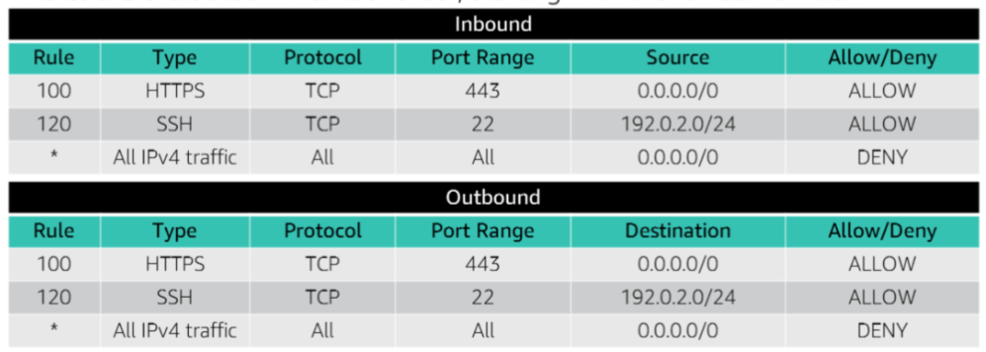
Network access control list (network ACLs)

Slide 10
THANKS
DO YOU HAVE ANY QUESTIONS

